Slide 1
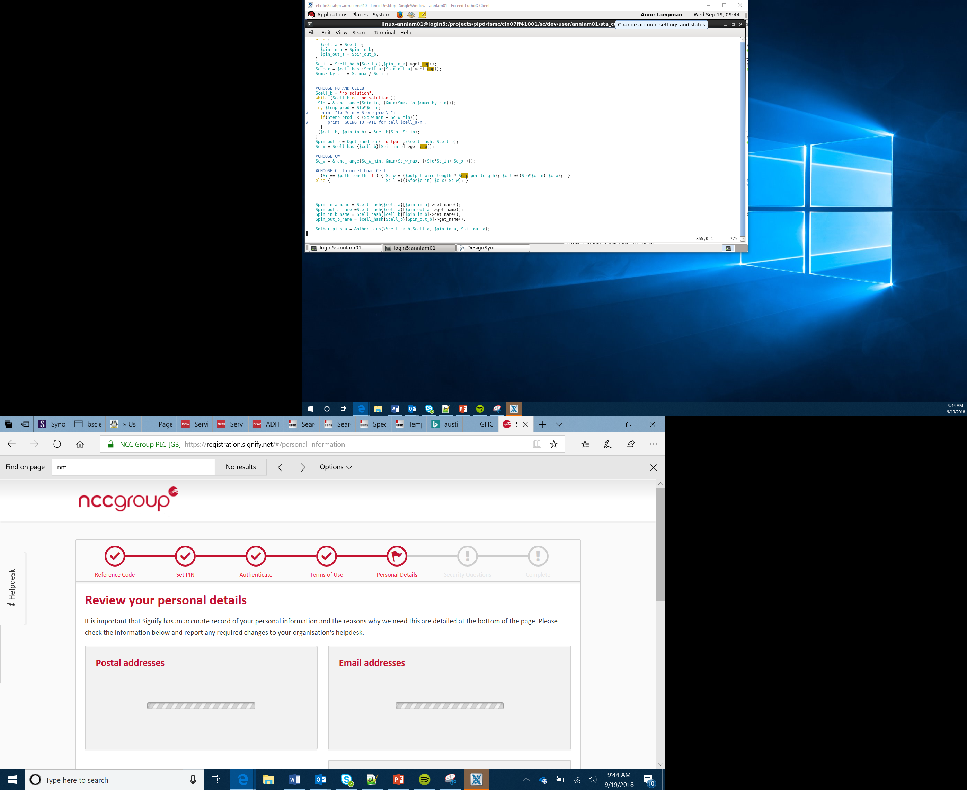

Smart Car
Collision Avoidance System
Lesson 20

Slide 2
Objectives
Understand how an ultrasonic sensor can be used to create a collision avoidance system
Be able to calculate the distance to an object
Design an algorithm for a collision avoidance system
Create and test an algorithm for a collision avoidance system
Notes:
Share objectives with the group
Refer back to lesson 4

Slide 3
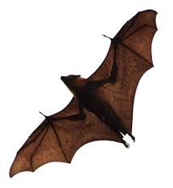
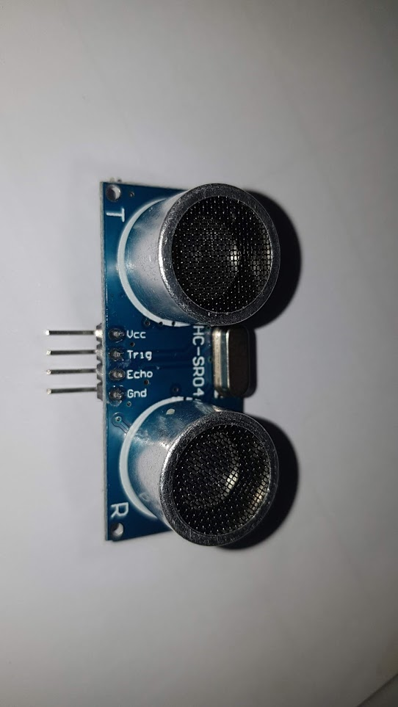
HC-SR04 Ultrasonic Sensor
The HC-SR04 is an ultrasonic sensor that uses sonar to determine distance to an object – just like a bat
Provides non-contact range detection for obstacle avoidance or collision detection systems
Sensor works from 2cm to 400cm and as it uses sound waves it is not affected by sunlight or dark materials
How It Works
The transmitter sends a signal of high frequency sound
When the sound finds an object it is reflected
The receiver receives the signal (the echo)
The time between transmission and reception of the signal allows us to know the distance
This is possible because we know the velocity of the sound through the air
Notes:
Explain the principles behind the ultrasonic sensor – link this to bats and submarines etc

Slide 4
Calculating Distance
Knowing the speed of sound at our current position and how long it takes to send and receive an ultrasonic ping, We can use some simple maths to calculate the distance to an object:
Speed of sound = 343 metres per sec (m/s)
Distance = Velocity * Time
Distance sound travels = Speed of sound * time
Distance to object = 0.5 * Distance sound travels
If a sensor sent out a ping to an object and it took 0.25 sec to receive a response how far away in metres is the object?
Distance Sound Travels = 343 * 0.25
= 85.75 m
Distance to Object = 0.5 * 85.75
= 42.87 m or 428.7 cm
Notes:
Demonstrate how to calculate distance using ultrasonic and use the lesson worksheet to get Learners to complete some simple calculations
Remind Learners how to convert between metres and centimetres if required as well as between seconds and microseconds

Slide 5
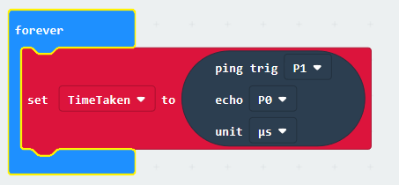
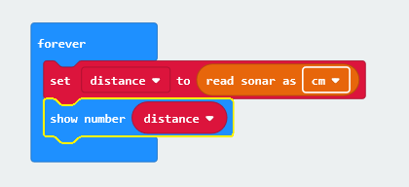
HC-SR04 Ultrasonic Sensor
We can use the Sonar extension in MakeCode to enable us to use the ultrasonic sensor
There is also a pre-built block in the Bit:Bot extension if you are using the Bit:Bot chassis
If you are using the sensor without the Bit:Bot chassis you need to ensure you have 5v powering the sensor. The standard output from the micro:bit is only 3v and might not be enough to power the sensor reliably
Notes:
Get the Learners to complete the pseudocode algorithm on their worksheet and then test their algorithm using the sonar extension.
Encourage the Learners to calculate the distance themselves in the program rather than just returning the distance in the function

Slide 6
Success criteria
Understand how an ultrasonic sensor can be used to create a collision avoidance system
Calculate the distance to an object
Design an algorithm for a collision avoidance system
Create and test an algorithm for a collision avoidance system
Notes:
Work through the lesson activity sheet and encourage Learners to complete the Stretch Tasks

